Slide 1

ECE 499: FPGA BASED HARDWARE ACCELERATOR FOR
REAL TIME IMAGE COMPRESSION
Yicheng Zhou
Advisor: Prof. Thomas Moon
12/04/2024

Slide 2
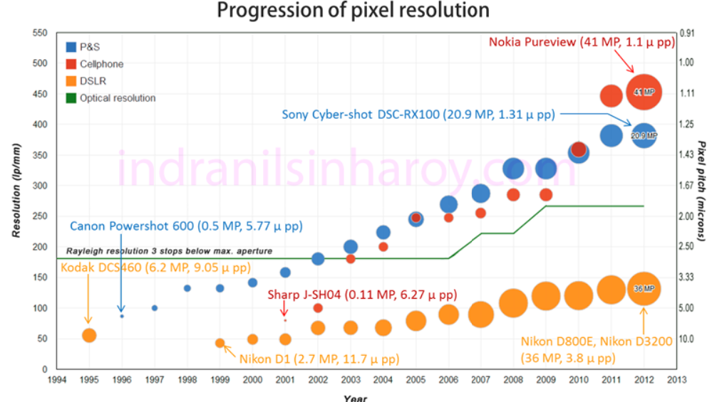
Motivation
[1]
Increasing resolution and frame rates in modern sensors
Challenges in initial data transmission and processing
FPGA-BASED HARDWARE ACCELERATOR FOR REAL-TIME IMAGE COMPRESSION
[1] Sinharoy, I. (2014, February 9). Progression of pixel resolution in digital cameras. Indranil's World. Retrieved from https://indranilsinharoy.com/2014/02/09/pixel-resolution-in-digital-cameras/
ELECTRICAL & COMPUTER ENGINEERING
GRAINGER ENGINEERING
Notes:
Background
Traditionally image/video compressing is implemented with CPU/GPU based system as a storage solution
Increasing resolution and frame rates in modern sensors have created challenges in initial data transmission and processing
FPGA can be commonly found in modern imaging systems, however they are typically only used for sensor control with little to no data processing

Slide 3
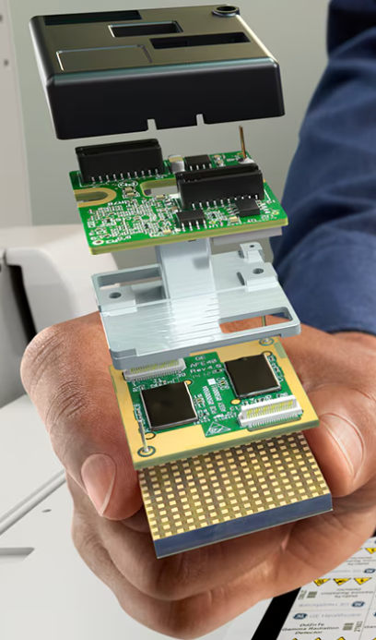
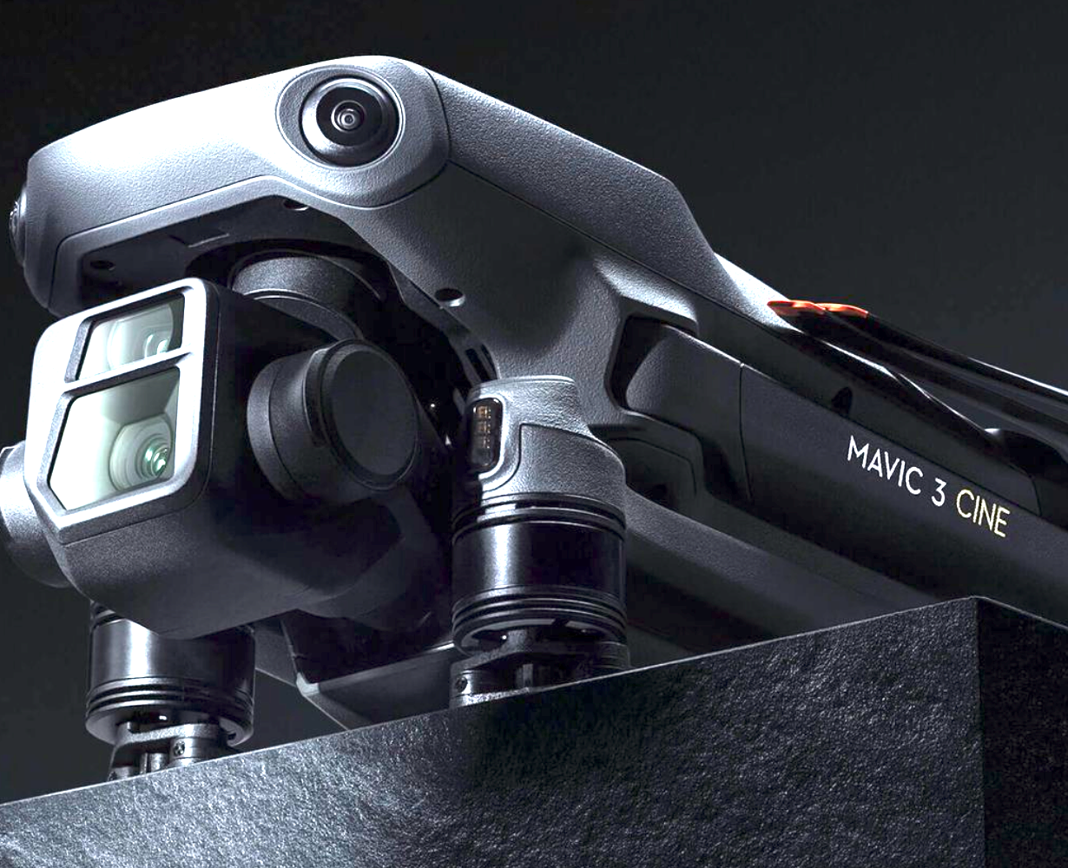
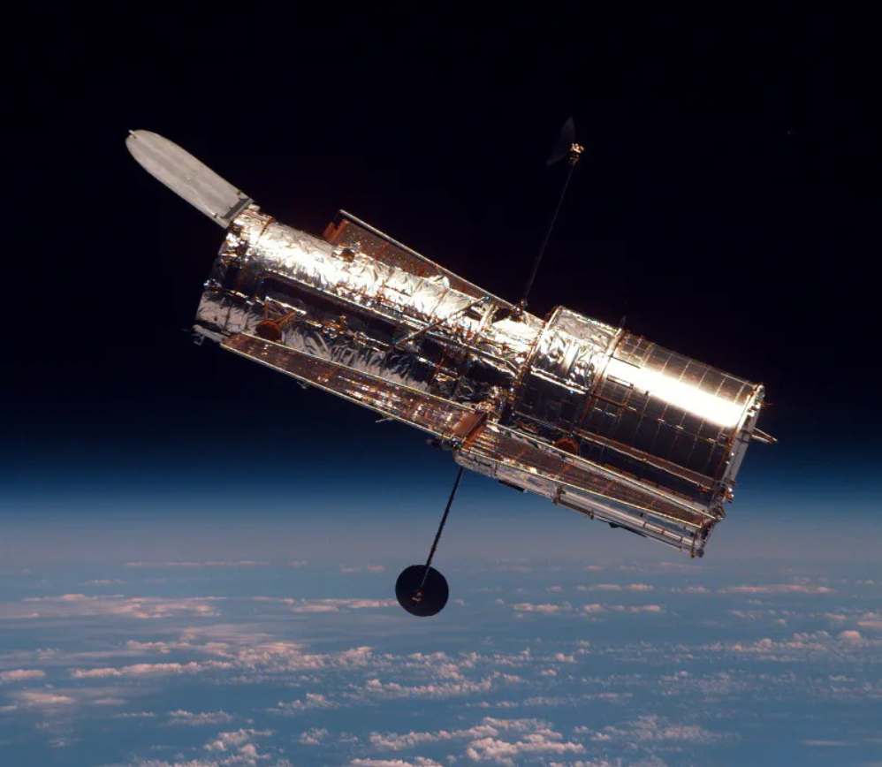
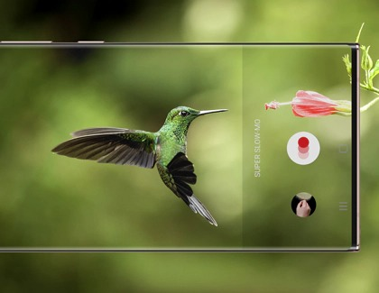
Motivation/Application
Medical Devices
Drones (Aerial Photography)
Satellite Imaging
Mobile Devices (Slow Motion)
National Aeronautics and Space Administration. (n.d.). Hubble observatory. NASA Science. Retrieved from https://science.nasa.gov/mission/hubble/observatory/
Samsung. (n.d.). Next level slow motion with Super Slow-mo on Galaxy phones [Image]. Samsung Support. Retrieved from https://www.samsung.com/us/support/answer/ANS10001595/
Zeeff, D. (2021, November 5). DJI announces the dual-camera Mavic 3 drone. DJZ Photography. https://www.djzphoto.com/blog/2021/11/5/dji-announces-the-dual-camera-mavic-3-drone
GE HealthCare. (n.d.). NM/CT 870 CZT. GE HealthCare. https://www.gehealthcare.com/products/molecular-imaging/nuclear-medicine/nm-ct-870-czt
ELECTRICAL & COMPUTER ENGINEERING
GRAINGER ENGINEERING

Slide 4
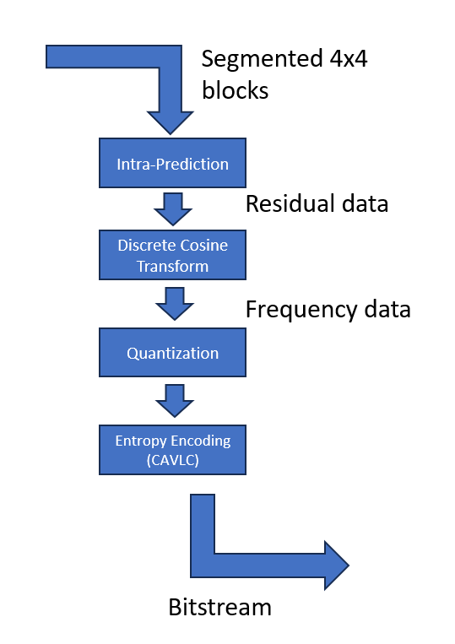
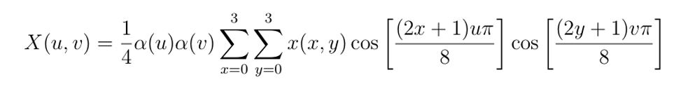
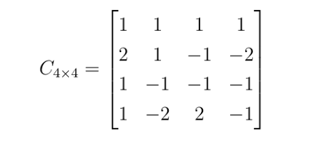
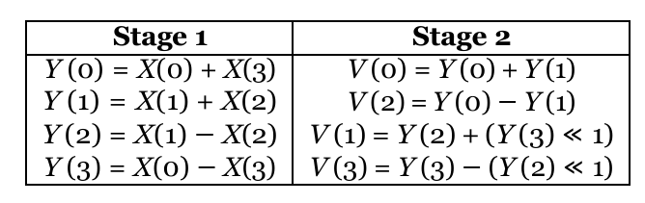
Compression Workflow Overview
H.264 Standard by ITU-T
Intra-Prediction: Exploits spatial redundancy between pixels to reduce data size.
Discrete Cosine Transform (DCT): Converts spatial data into the frequency domain
Quantization: Reduces precision of less important frequency components
Entropy Encoding: Compresses the data into compact bitstream using algorithms like CAVLC
Project-Specific Implementation
Pipeline optimized for FPGA using integer approximations for DCT to reduce computation overhead
Entropy Encoding is simplified to reduce resource utilization and enable parallel processing
ELECTRICAL & COMPUTER ENGINEERING
GRAINGER ENGINEERING

Slide 5
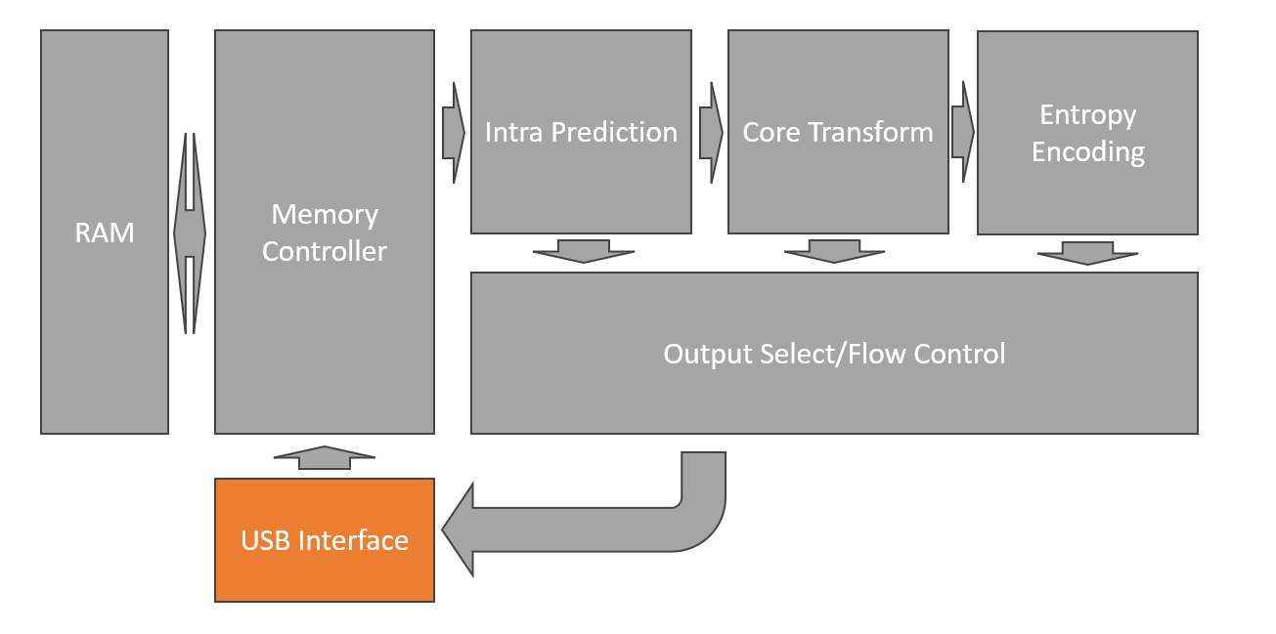
System Architecture
Project-Specific Architecture
USB Interface: Manages data flow between FPGA and PC
Memory Manger: Efficiently stores, retrieves and parse data to and from dual port distributed memory
Computation Units: Including the Intra-prediction, core transform and entropy encoding
Output Parser: Prepares compressed data for transmission and formats it approprately
ELECTRICAL & COMPUTER ENGINEERING
GRAINGER ENGINEERING

Slide 6
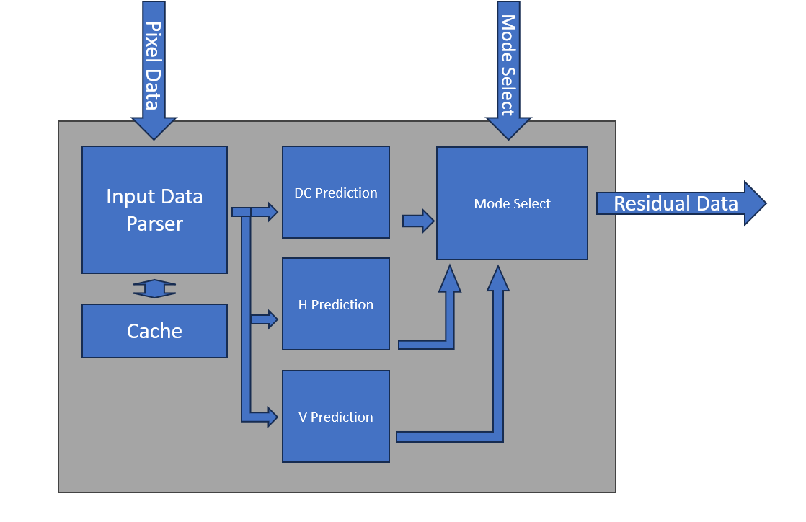
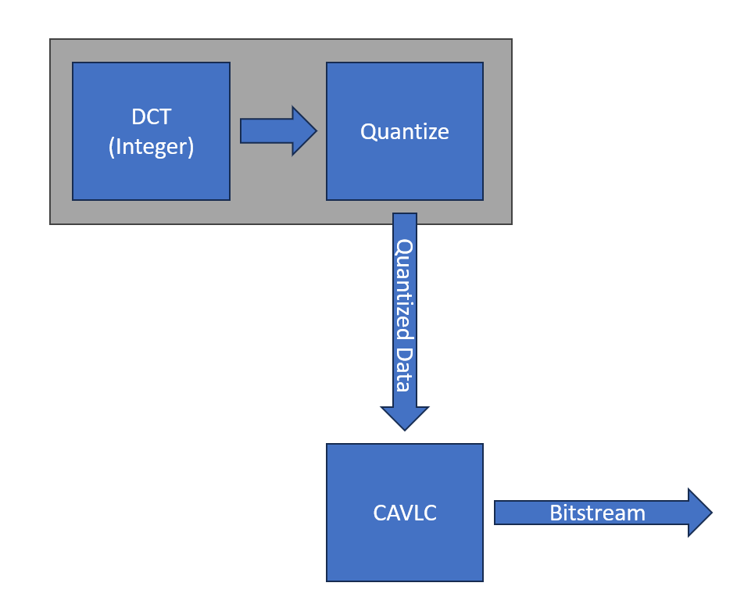
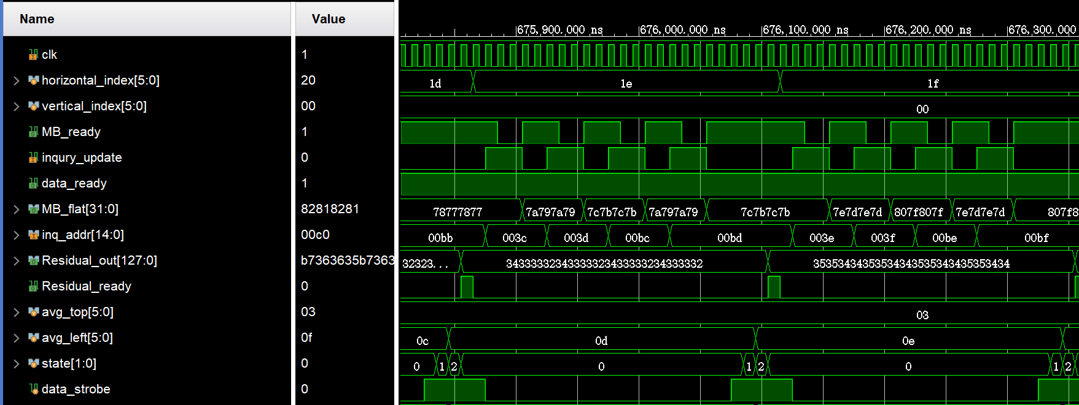
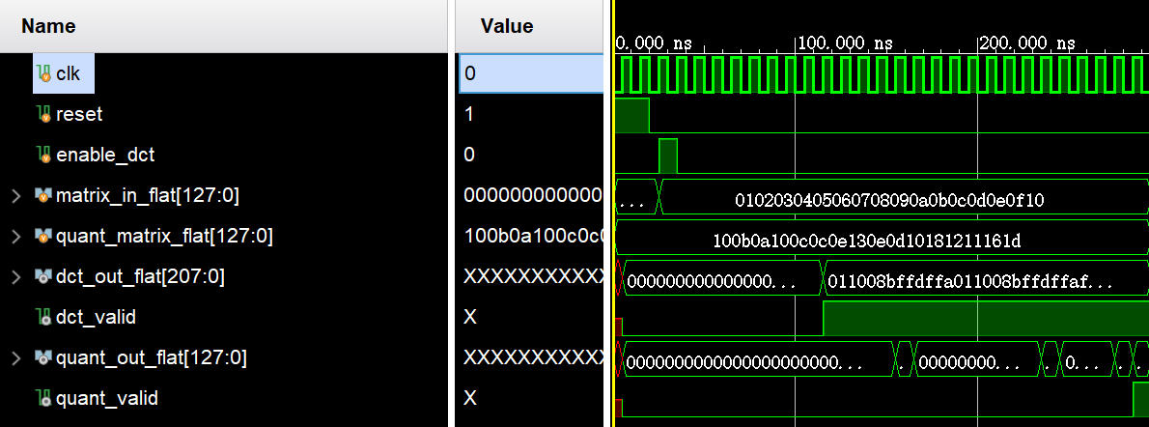
Computational Units
Implementation highlight
Intra Prediction: 3 modes available with manual or automatic mode selection
Core Transform: DCT and Quantize are grouped together due to similar processing time
ELECTRICAL & COMPUTER ENGINEERING
GRAINGER ENGINEERING

Slide 7
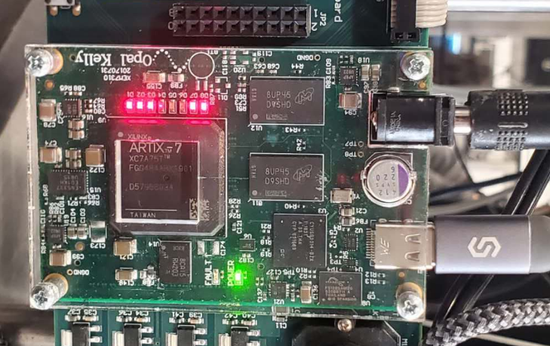
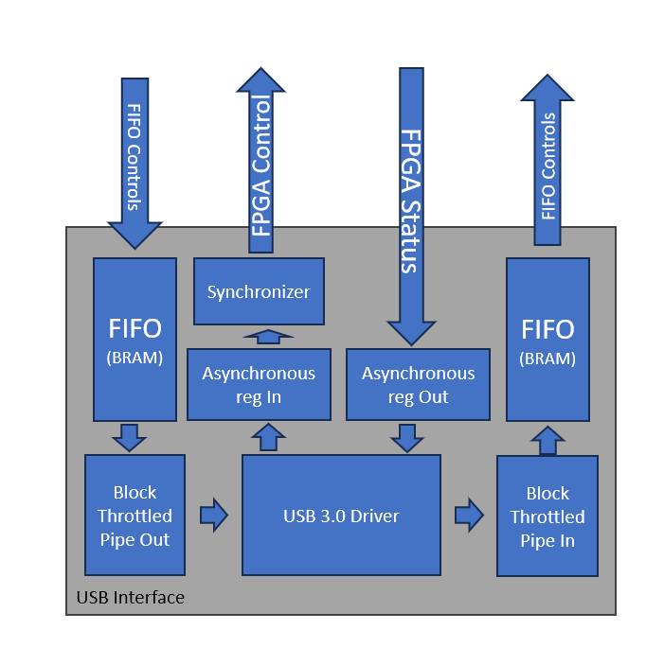
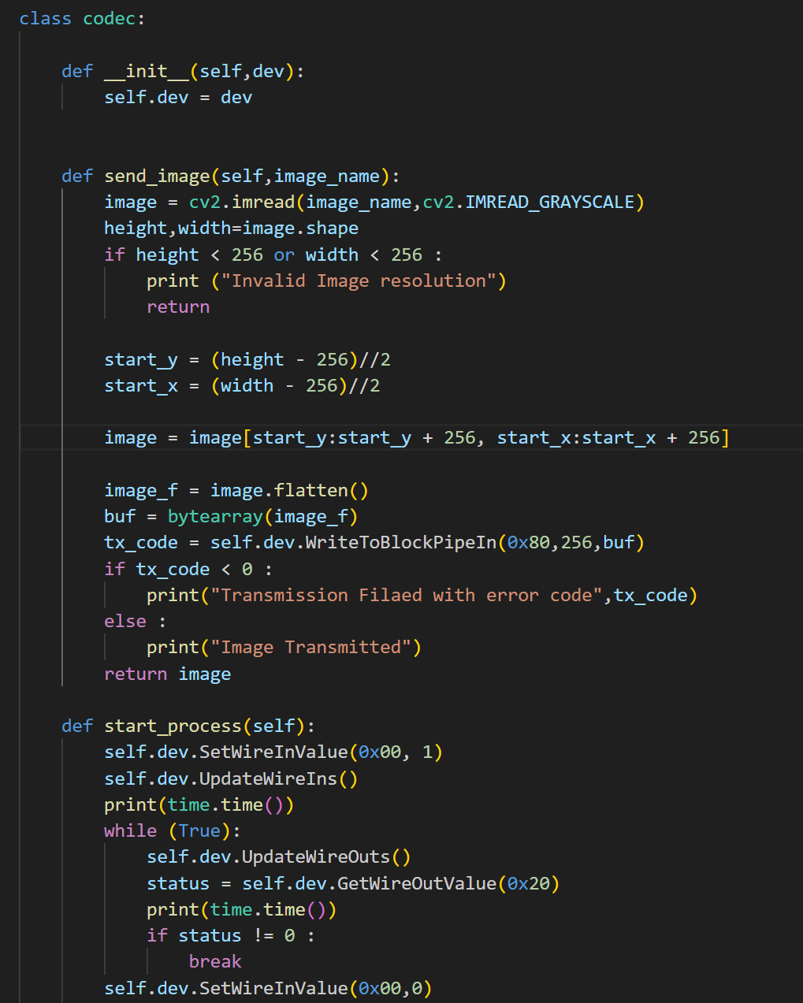
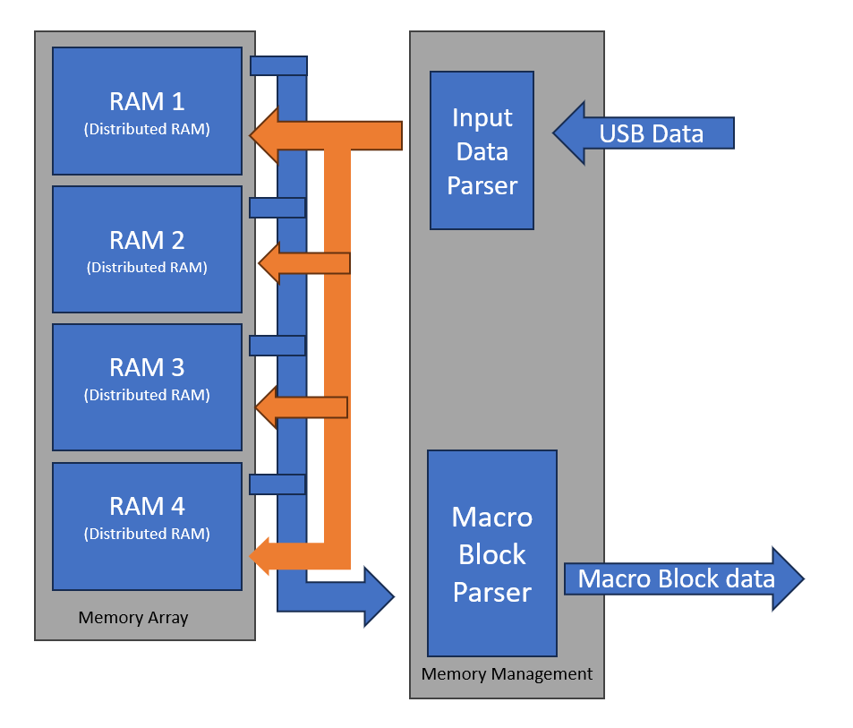
Experimental Setup
Project-Specific Architecture
Memory Controller: Distributed Memory utilized to store simulated image, could act as buffer or discarded for live inputs
USB Interface: OpalKelly USB 3.0 development kit for high-speed data transfer between the FPGA and the PC.
Python: A script is developed to transmit and receive data, control FPGA and decode the received data.
XEM7310: The FPGA development board from OpalKelly which also includes USB 3.0 HDL library and python API
ELECTRICAL & COMPUTER ENGINEERING
GRAINGER ENGINEERING

Slide 8
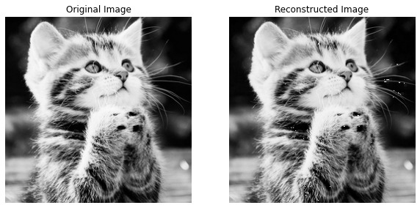
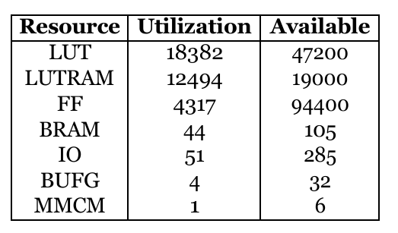
Results and Analysis
Resource Utilization | Latency | Compression Ratio
~48% Usage in Artix-7 A75 | 1.2ms ~ 1.5ms / Frame(256x256) | Best Case 8:1, Average 3:1 ~ 4:1
ELECTRICAL & COMPUTER ENGINEERING
GRAINGER ENGINEERING

Slide 9
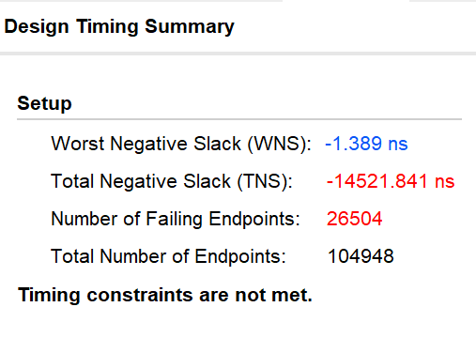
Challenges
Intra Clock Timing Closure: The Use of large distributed RAM at high frequency resulted in significant timing violation
Inter Clock Sigal/Data Crossing: With data and signal crossing from USB 3.0 (asynchronized clock), safe handling of signals are challenging
Pipeline Flow Control: Pipeline flow control posted unexpected challenges due to various causes such as USB controller delay, throughput mismatch, and edge triggering.
ELECTRICAL & COMPUTER ENGINEERING
GRAINGER ENGINEERING

Slide 10
Conclusions
Conclusion
successfully demonstrated the FPGA based pre-CPU image compressor
implementing and testing the design on FPGA,
lower latency, higher throughput and higher bandwidth implementation on higher end hardware.
Future work
While purely intra-frame prediction method yielded satisfactory results, inter-frame prediction methods as specified in the H.264 standard could yield much higher compression ratio, at the cost of higher latency, however the balance between them is worth exploring.
While USB 3.0 is capable of very high data rate, it is one of the bottleneck for the throughput of the design, it is worth exploring other data transmission method with higher bandwidth, such as PCIE and DDR
ELECTRICAL & COMPUTER ENGINEERING
GRAINGER ENGINEERING

Slide 11
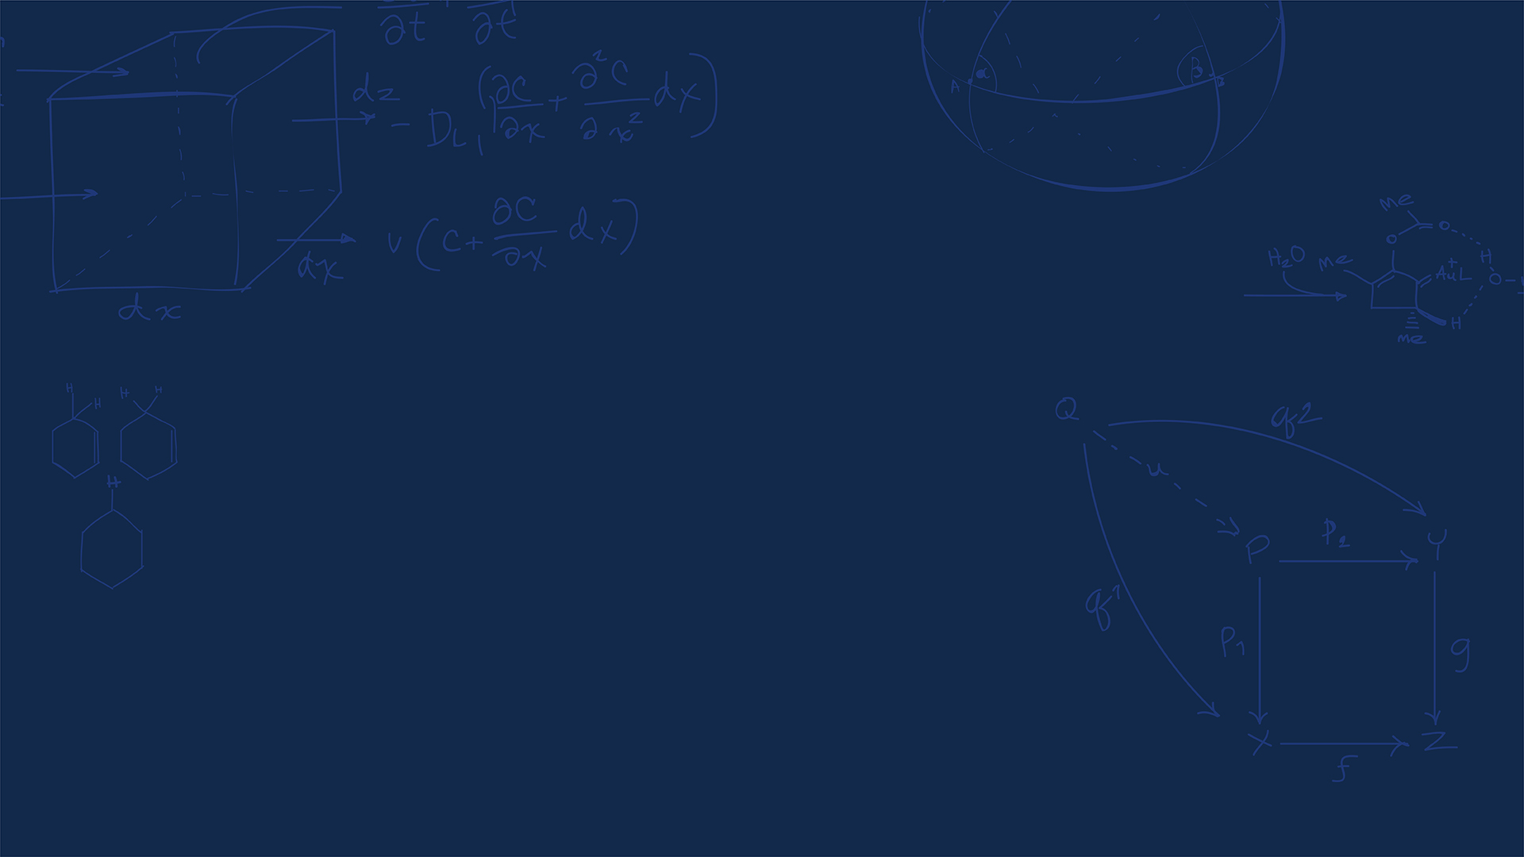
Thank You!
Q&A
ELECTRICAL & COMPUTER ENGINEERING
GRAINGER ENGINEERING

